Slide 1
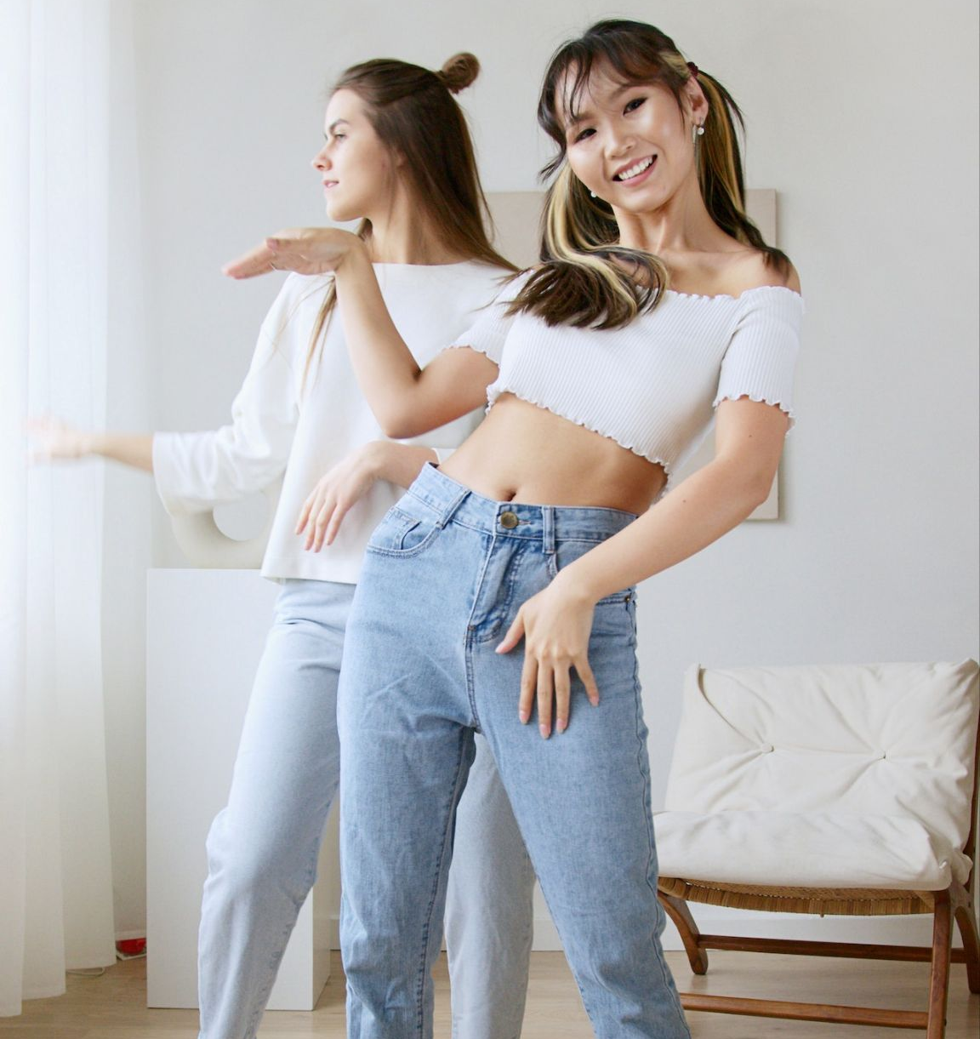


Fresh: Customer Success Plan 2023

Slide 2
Fresh Org Structure
Amy Jones - SVP of Performance Analytics DXI
Fatima Isabella Asis - Global Marketing at Fresh, LVMH
Hallie Gersten - Manager, Global Marketing, Lifestyle at Fresh
Meghan (Meg) Cannon -Global Marketing Manager at Fresh (LVMH)
C’Loni Bailey -Partner Management Coordinator
Mariana Montoya, MPS - North America Brand Marketing, fresh at LVMH
Chanel Lake - VP of Influencer F&B/ Tech
Taelor Bakewell - VP of Influencer F&B/ Tech
Christopher Wallace - Global Head of Digital Experience and Innovation at Fresh
Juliana Hendershot - Vice President, North America Marketing - Fresh
Julie Gayet - Director, Global Operational Marketing North America at Fresh
Anne Urbain - VP Operations chez Fresh
Jean-Francois B. - VP, MIS at Fresh
Sarah Irby - Vice President, Global Marketing - Fresh (LVMH)
Christopher Hope- Vice President Global VMSD at Fresh
Amelia Peng - Senior Director, Global Operational Marketing at Fresh (LVMH)

Slide 3

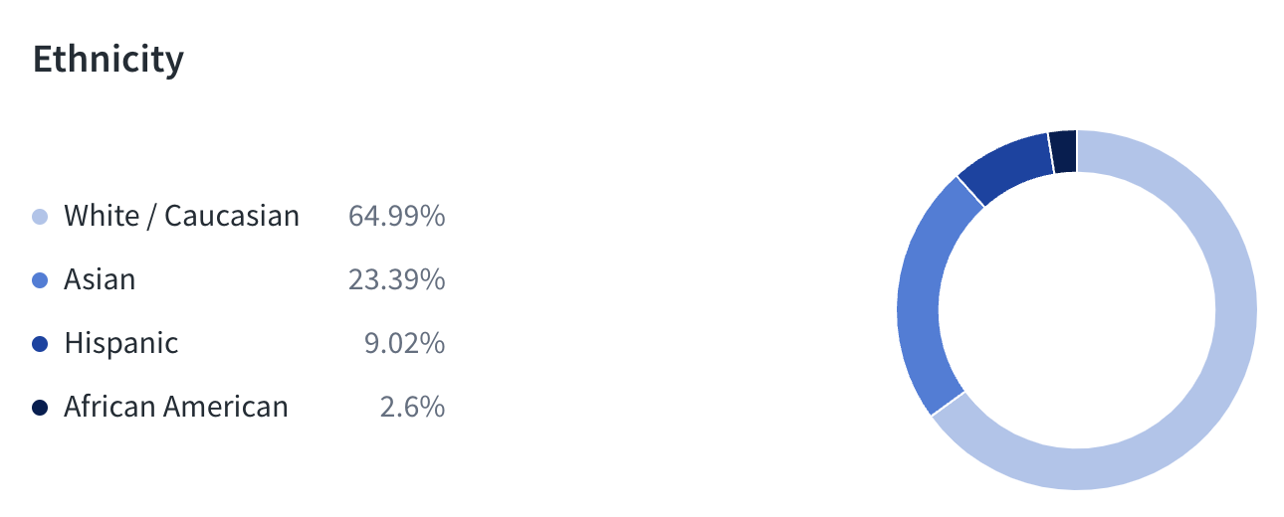
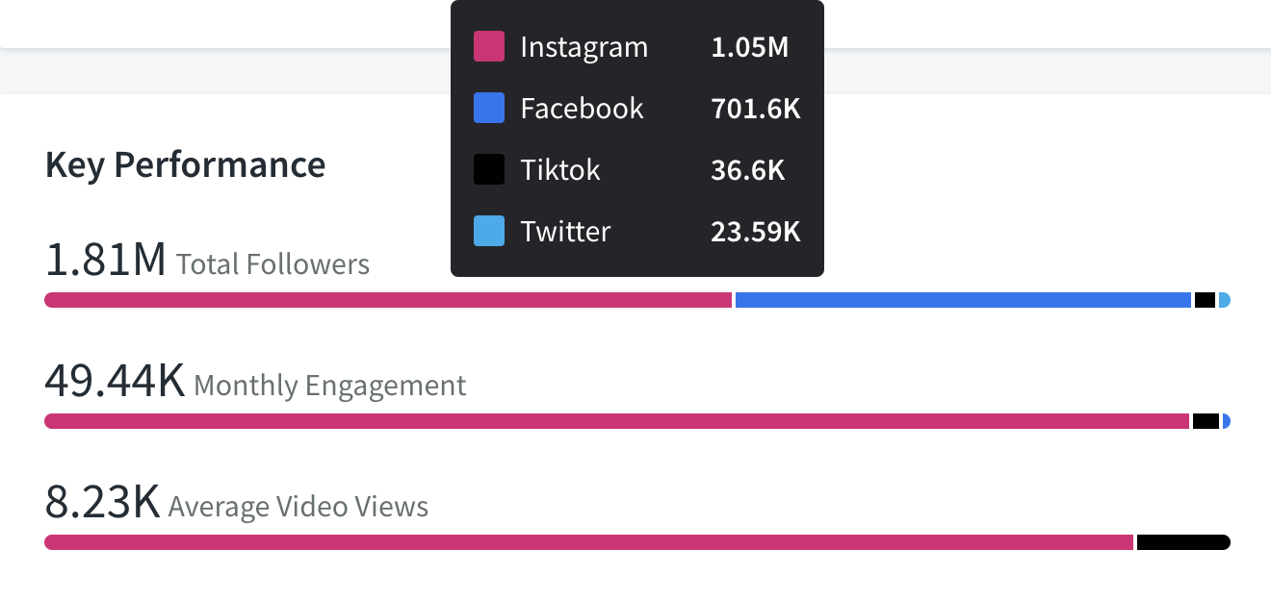
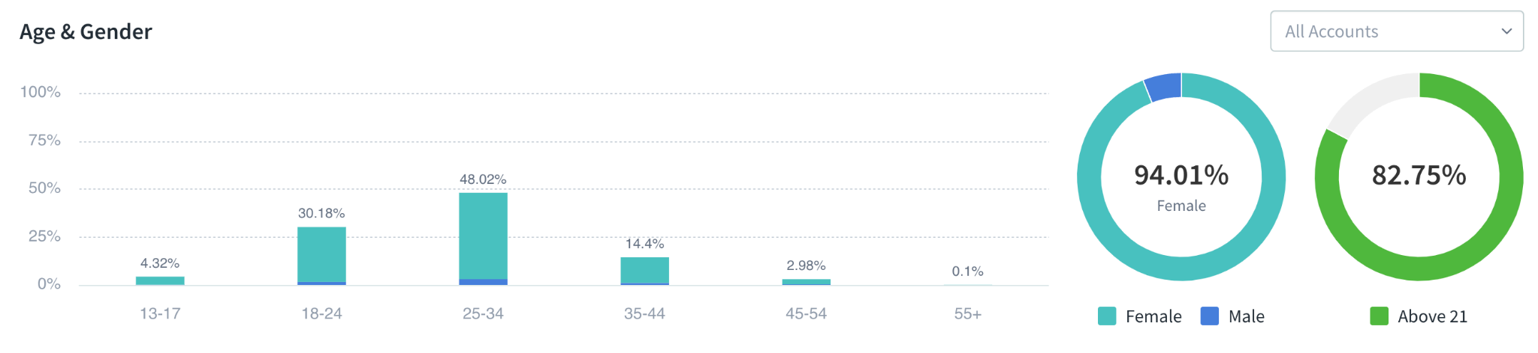
What We Know
Notes:
Fresh has good growth across their social platforms.
Almost 80% of Fresh’s target audience is GEN Z and Millennials.
Where are the areas for opportunity? To me, its TIK TOK and that is not a bad problem to have.
TikTok has established itself as the go to platform for Gen Z and us millennials and also a launchpad for viral trends around beauty, fashion, food, music, and so many other areas.

Slide 4
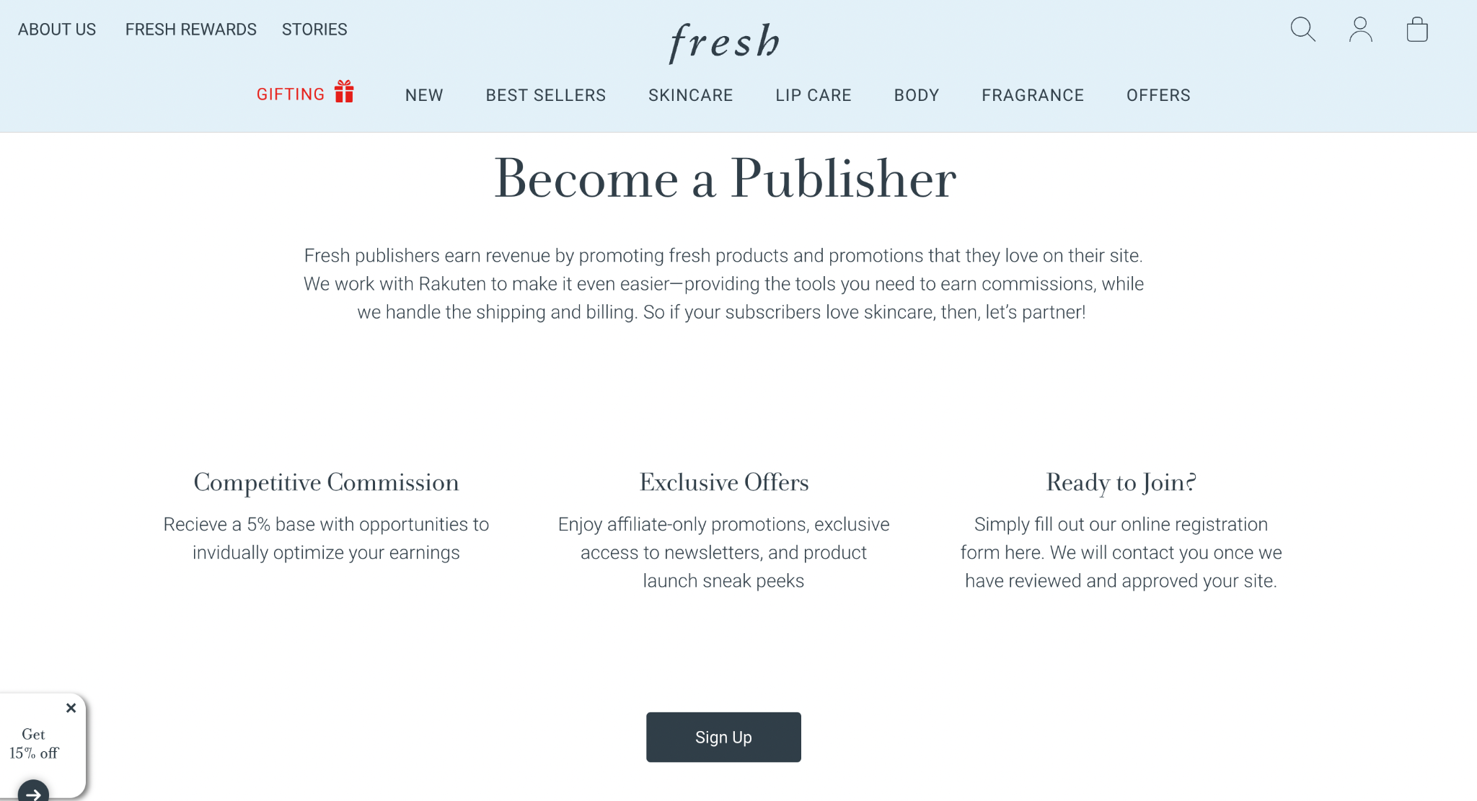
Notes:
Affiliate: for influencer partnerships to survive at Fresh it needs to save them money or make them money
How does working with us benefit them?
Creator: offsetting creator costs internally
Making money: 2023 → working with larger creators and including those links. Long-term we can set up 10-20 creators with affiliate links to use at their discretion.
Or if they have goals that aren’t focused on driving traffic necessarily. They may want to partner with creators for good will; positive message, and deliver X million impressions on that message
And Community is the best was to deliver that message.

Slide 5
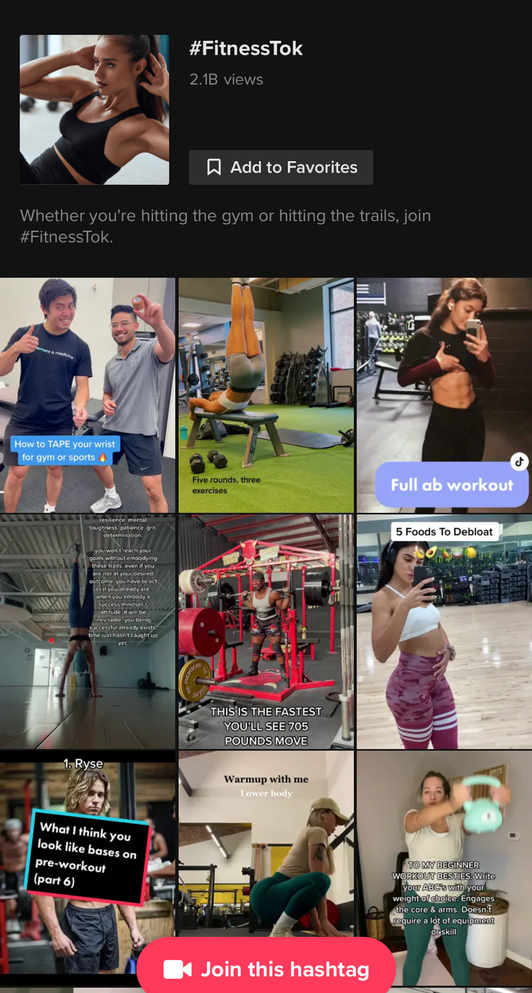
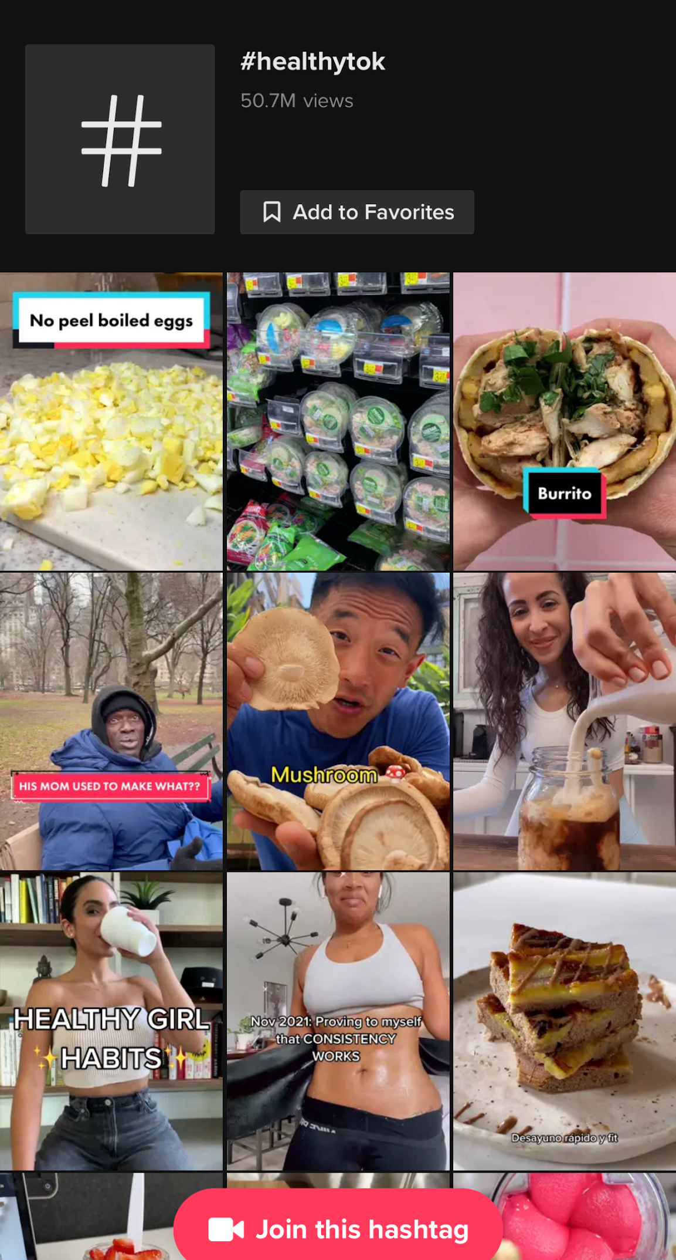
Community is King
Industry Outlook: Trends Driving Influencer Marketing
#Fitnesstok #HealthyTok #RecipeTok #ScienceTok– with the interest algorithms leading content discovery today, we’re seeing a nichification happen around viral, relevant content. It’s the beginning of the end of the “lifestyle” creator, and brands are shifting focus to key fandoms and creators
that have built true community vs. speaking to
massive audiences.
What we’re seeing
Shift from mass appeal to niche zeal
Increased ‘direct-to-fan’ content through platforms like Patreon, Cameo, and Substack
Impact
Focus less on creator follower count metrics, and more on content relevance in fandoms & communities relevant to your brand, THEN distribute content at scale from there.
Brands can tap into CIQ’s insights to delve into topics audiences care about most
Notes:
Industry Outlook: Community is King
And then in terms of industry trends, I totally appreciate that Fresh does not do much on TikTok yet but as we just spoke about Community is King right?
We're really seeing a shift from mass appeal to really niche topics. And then just being able to kind of have that direct to consumer direct a brand content.
I think it just really allows us to be able to leverage the uniqueness of that algorithm and tapping into those nano or micro influencers that really drives community
And really just generating that mass awareness even without that large reach.
We're seeing the Impact is just focusing less on the creator follower account metrics and just really being able to focus more on the content that they were organically producing and the brands that they're organically affiliated with, to really reach audiences in a more organic and authentic way.

Slide 6
Fresh Priorities/Opportunities
Key Initiatives for 2023
Discovery
Campaign
Management
Payments &
Contracting
Strategy
Focus Area
Find relevant influencers for Campaigns
Consistency in Campaign Management & Measurement
Streamlining & simplifying processes
Derive insights from competitive & content analysis
Outcomes
Educate team members on discovery & search best practices
Reduce time spent finding creators to partner with
Enhanced sources for talent identification
Centralize campaign execution through CIQ’s as system of record
Authenticate all talent to streamline tracking & measurement and streamline affiliate offering.
Simplify measurement
Drive awareness of CIQ’s payment capabilities
Track budget, deliverables and pay talent through CIQ’s payment solution.
Gather insights around content for campaign hashtags
Keep pulse on what people are saying in relations to a campaign
Monitor competitor’s paid influencers
Key Initiatives

Slide 7
Success Plan
Complete
In Progress
Future Project
Priority/Goals
Q1 (Jan - Mar)
Q2 (Apr - May)
Q3 (June - Aug)
Q4 (Sept - Dec)
Discovery Enhancements
Discovery
Discovery Workshop
Discovery Workshop
Discovery Workshop
Discovery Workshop
Campaign Adoption
Canada - Affiliate Marketing Launch
Campaign Management
TikTok Boosting
Link Tracking Adoption
Content Approval Adoption
Reporting Workshop
Reporting Workshop
Reporting Workshop
Reporting Workshop
Payment Adoption - US/CA
Payment Adoption - EMEA
Payments & Contracting
Contracting Adoption
Payments Workshop
Strategy
Insights Workshop
Insights Workshop
Combined Reports
Onboard Continued (LATAM/S.Korea, Australia)
Contract Renewal Discussions
Onboard APAC
Other
Onboard Saudi Arabia
Onboard South Africa
User Cleanup - International

